Slide 1

A Campus-Wide Learning Community: Becoming Agents of Change
Kentucky State University
Academics with Attitude
Dr. Titilayo Ufomata, Associate Provost
Ms. Sue Stamper, Director
Enhancement and Retention Program

Slide 2

Kentucky State University
HBCU
Full-time Undergraduate Enrollment ~ 2,106
1st Generation ~ 1,543 70%
Low-Income ~ 1,060 39%
Developmental Placement ~ 80%
Retention ~ 49%, 52%, 54%
Graduation ~ 23%, 23%, 25%

Slide 3
According to Hunter Boylan (1999) students in developmental courses leave college for several reasons:
Personal and family problems interfere with attendance.
They never acquire the skills necessary to pass developmental courses.
They become bored from or discouraged by having to take developmental courses
They use up their financial aid by taking developmental courses and fall into increasing levels of debt.

Slide 4
How many students struggle in developmental courses?
According to Hoyt (1999), about 30% of students who enroll in developmental courses across the U.S. fail to successfully complete them and then move into regular college classes.
But the percentage is greater at KSU.

Slide 5
Well, we offer programs to help students with these factors so they’ll succeed……
And way too many still fail.
So, what is the problem?

Slide 6
Well, non-academic factors also play a crucial role in student engagement in and persistence through a program of postsecondary study. These include….
non-cognitive factors
attitudinal factors
the experiences and aspirations that students bring to college
the experiences and aspirations that students develop during the college

Slide 7
So, what did we do at KSU?
We sat down.
We talked.
We looked at the data.
We planned.
We aimed high.
We got very frustrated.
We repeated the process until we reached a consensus.
We stuck our necks out and aimed very high.

Slide 8
We did our homework. . .
We consulted the mother and fathers of best practices:
Alexander Astin (student engagement
Hunter Boylan (developmental education)
Ruth Keimig (learning improvement planning)
John Gardner (first year experience; multiple intelligences)
Vincent Tinto (learning communities)

Slide 9
What we did . . .
Started with a small project.
Built on our institutional history of service to underprepared students;
Used our stated mission to “prepare leaders committed to continuous improvement of the opportunities for expression and participation in the life of the University, the Commonwealth, the nation, and the world (KSU 2007-2008 Catalogue).

Slide 10
What we also did . . .
Recognized our 2005 Developmental Education Committee Recommendations;
Seized the opportunity to mesh part of our accreditation process with the SACS quality enhancement plan by focusing on our tremendous developmental/ preparatory education needs; and
Designed the Academics with Attitude 2008 pilot.

Slide 11
How we did it . . .
We established the parameters of our cohort based on the first tier of developmental need
  ACT English sub scores of 15 or below
  AND
  ACT Reading sub scores of 15 or below
  AND
  ACT Math sub scores of 18 or below
  (or SAT equivalents)

Slide 12
The Program
Academics with Attitude:
Building the Foundations for Student Success

Slide 13
Academics with Attitude:
The Premise
The academic pursuit is the concerted endeavor of the entire KSU community, faculty, staff, and students, not students alone.

Slide 14
Definition of Attitude
Attitude must be inclusive.
The Academics with Attitude project reflects the entire university’s positive commitment to continuously change to improve teaching and learning.

Slide 15
All Stakeholders Recognize the Attitude
This attitude is recognition among all stakeholders on campus that social, political, and economic factors in our contemporary society continuously impact and change the profile of young people and the ways they learn, and that the KSU community must respond differently.

Slide 16
All Stakeholders Comprise the Learning Community
Our academic community must be ready
  to adapt to the new ways that our young adults participate in life and learning, and
  to adopt changes in attitude that will foster learning and self actualization.

Slide 17
Academics With Attitude: Purpose
KSU learning community should be actively engaged in the development, practice, and assessment of a developmental-gateway freshman project.
The AWA project should be an interrelated academic program in which students’ academic and cognitive development is supported by the KSU community.

Slide 18
Academics with Attitude: Design
The KSU “Academics with Attitude” is best conceived as a cycle of university community attitudes that are continuously affective as well as effective.

Slide 19
Continuous Learning Support Cycle
Faculty committed
to continuous improvement of positive, constructive methods of teaching.
Administration and staff committed to continuous, positive, constructive funding and support of developmental education.
Students committed to continuous acquisition of developmental knowledge, skills, and attitudes needed for promotion to college level courses and programs, active engagement in academic study, academic and personal support programs, and living-learning communities.

Slide 20
Faculty attitude is continuously committed to
leading the change.
improvement of positive, constructive methods of teaching that improve students’ engagement in learning.
engaging students in learning through engaged teaching.

Slide 21
Student attitude is continuously committed to
active engagement in academic study,
instructional support programs;
academic advising;
personal counseling programs;
living-learning communities; and
acquisition of developmental knowledge, skills, and attitudes needed for promotion to college level courses and programs.

Slide 22
Administration and staff attitudes are continuously committed to
continuous positive, constructive funding, and
useful, proactive support of developmental education.

Slide 23
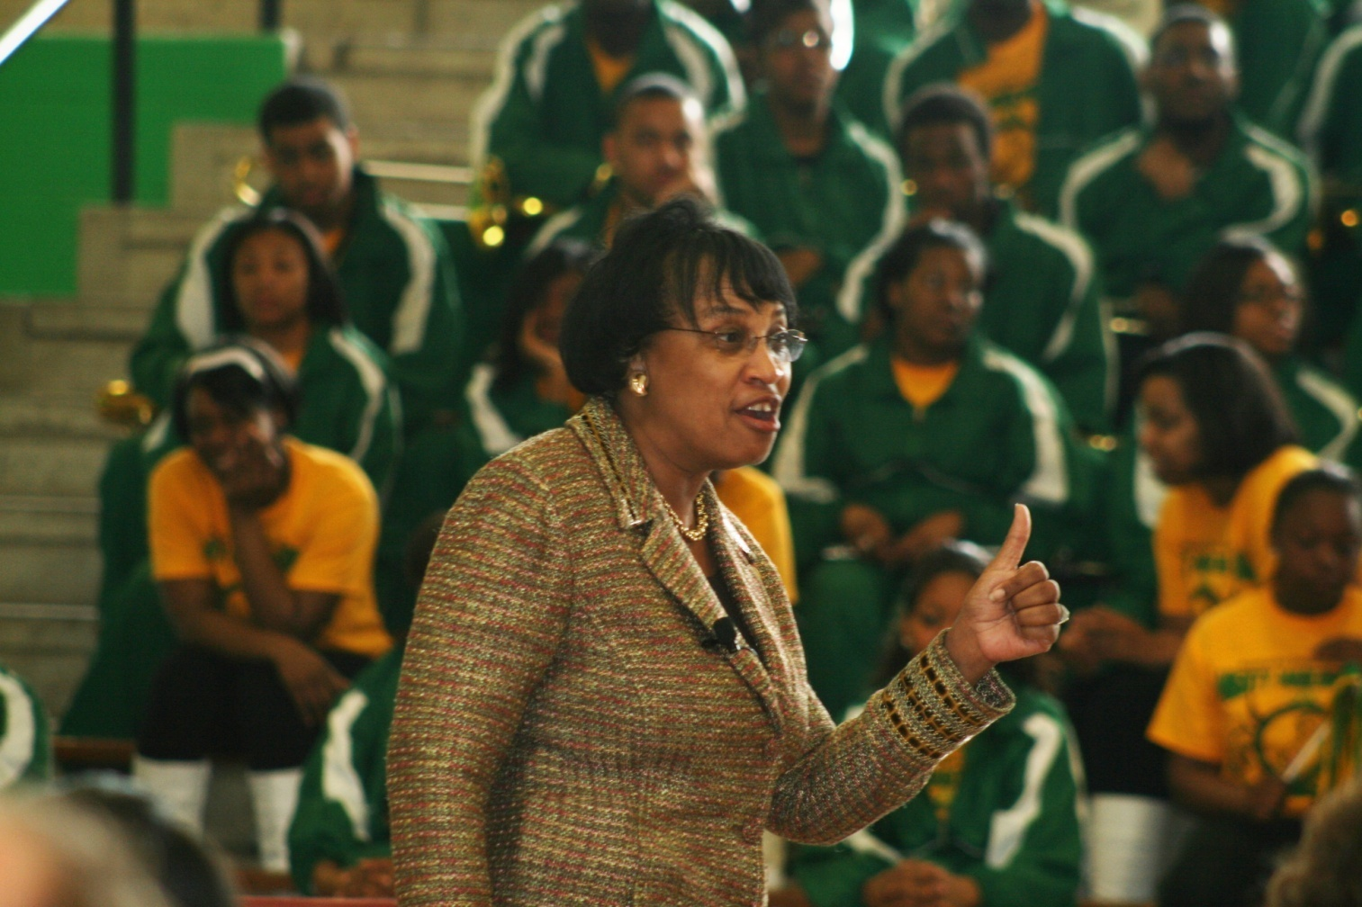
The “Kick-Off”
Presidential Support

Slide 24

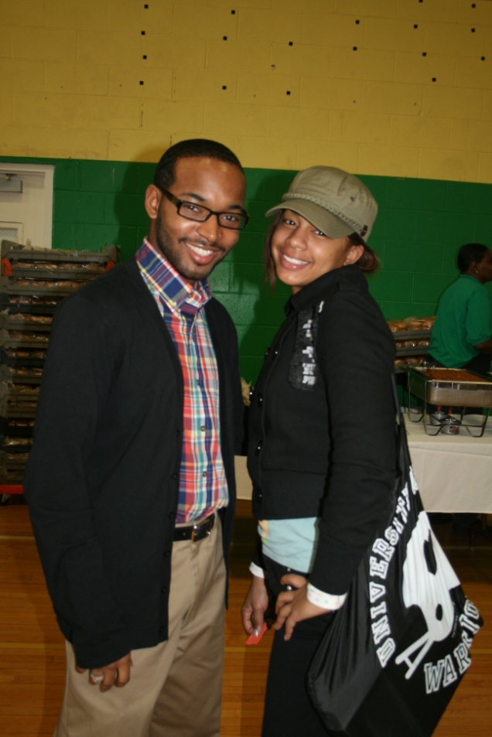
Student Awareness

Slide 25
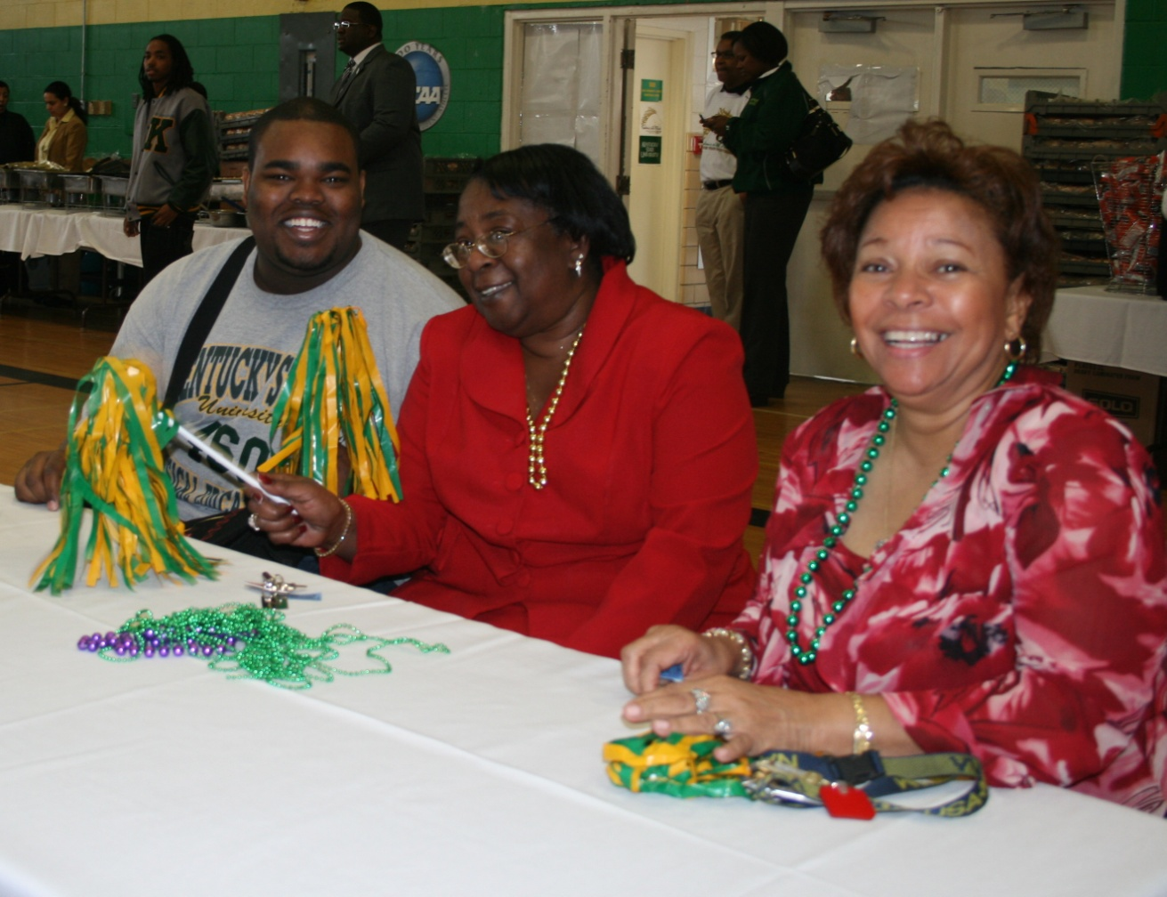
Faculty/Staff Participation

Slide 26
UNV 101
Professor/Advisor Model

Slide 27
UNV 101
…. the hub course for all incoming freshmen enrolled in at least one developmental course

Slide 28
Our Underlying Premise….
Student engagement binds students to each other ...
and to the institution ...
and promotes positive attitudes related to meaningful learning activities.

Slide 29
Basic Goal of UNV 101
Through engaging students in a systematic support network of AWA 101 instructors who have a teaching and advising role...
students will develop positive attitudes...
that lead to productive behaviors...
that promote academic success.

Slide 30
Like what kind of productive behaviors?
Strong commitment to the goal of graduation
Realistic view of academic expectations
High self-efficacy
Feelings of self-worth
Internal “locus-of-control”
Willingness to seek help
Adaptation to change (e.g. personal growth and development)
Application of time management principles
Willingness to address areas of weakness
Willingness to work with other students (e.g. peer mentors, group study)
Positive view toward educators and respect for the academic community

Slide 31
The UNV 101 Professor/Advisor will ….
Serve as the student’s UNV 101 professor for one semester
Serve as the student’s advisor for at least three semesters – when they are no longer your students
Collaborate with the professors of the developmental classes in the ENG and MAT courses that the student is enrolled in
Collaborate with Registrar’s Office, Admissions, Financial Aid, Student Life, Residence Life, Advising, Service Learning, Student Affairs, etc.

Slide 32
The UNV 101 Professor/Advisor will also….
Meet with the AWA Teaching Team weekly to discuss student’s progress for three semesters
Meet with the student regularly during the semester to discuss his/her performance
Serve as the student’s ombudsman in a variety of situations (Patrick’s situation)
Provide information to the student’s parent/guardian as upon request (FERPA)

Slide 33
Academic Center for Excellence

Slide 34
Academic Center for Excellence
80% - 94% Success Rate in Tutored Classes
One-on-One and Small-Group Supplemental Instruction
Self- or Faculty-Referred Student Clientele
Peer Tutors and Professional Instructional Counselors

Slide 35
Academic Support Characterized by:
Professional Standards
Critical Thinking Process
Talent Development/Constructivist Philosophy
Inductive/Socratic Approach
Student Engagement and Personal Responsibility

Slide 36
Academic Support Characterized by:
(continued…)
Multi-Dimensional Learning Styles
Faculty and Administrative Support
Campus-Wide Involvement
Positive Peer Influence
Atmosphere of Trust

Slide 37

“ACE”

Slide 38

“ACE”

Slide 39
Structural Levels of
Learning Improvement Programs
Level I Stand-alone developmental courses
Level II Learning assistance for individual students expected to seek tutoring
Level III Course-related learning services coordinated through assigned activities
Level IV Comprehensive learning systems such as learning communities
As institutions move from Level I to Level IV, the impact of instructional support increases.
Ruth T. Keimig

Slide 40
Structure
Students attend their normal 3 credit hour developmental course in math.
Student would meet an additional 2 times per week (50 minutes each) for seminars for each course.

Slide 41
Strengths
There were many…

Slide 42
How did we do in our first semester? Great!
Course | 2008 Cohort % passing | 2008 Control % passing
Eng 088 | 87.9 | 73.1
Eng 089 | 93.1 | 68.3
Mat 095 | 73.2 | 51.3
Unv 101 | 87.9 | 78.0

Slide 43
How did we do second semester?
Course (s) | 2009 Cohort % Passing | 2009 Control % Passing
Eng 088 | 67% | 76%
Eng 103 | 70% | 34%
Mat 095 | 71% | 26%
Mat 097 | 48% | 56%

Slide 44
Academic Standing
Cohort | Fall 2.0 or Better GPA | Next Term Probation
Summer 2010 AWA Cohort N=99 | 95% | 0%
Control Group Fall 2010 Entry N=51 | 55% | 37%

Slide 45
Retention
Cohort | AWA Group | Control Group
Fall ‘08 – Fall –’09 | 62% | 27%
Summer ’09 – Fall ‘10 | 64% | NA
Fall ‘09 – Fall –’10 | 74% | 55%

Slide 46
What Works?
Fully Integrated Classrooms and Laboratories Result in
Significantly Higher Pass Rates in Developmental Courses
(Boylan, What Works: Research-Based Best practices
in Developmental Education 2002)

Slide 47
Integrated Classroom Activities and Laboratories Characterized by
Instructor and Laboratory Personnel Consultation in Course Development
Seminar Materials and Activities Directly Related to Course Goals/Objectives
Required Student Participation in Seminar Activities as Course Assignments
Seminar Activities Count as Part of Students’ Grades
Seminars are in Reasonably Close Proximity to Courses they Support (Boylan)

Slide 48
Tips on Integration of Classrooms and Laboratories
Instructional Seminars should not Replicate Instruction, but
Provide Activities that Supplement Instruction and
Appeal to a Wide variety of Learning Styles
Faculty Expectations for Seminars are Included in Course Syllabus
Seminars Seen as Continuation of Classroom Learning Process

Slide 49
Challenges
There were many…

Slide 50
You want me to do what?
We want you to help us help these kids ... or get out of the way.
Notes:
50

Slide 51
Cross-Divisional Collaboration

Slide 52
Preparation
Faculty training on differentiated instruction towards student learning styles
Planning of seminars for their most effective use

Slide 53
Instructor Requirements
It is best when instructors are willing to immerse themselves within the activities of the learning communities.
Carefully weigh the thin line between providing support that builds a student towards success vs. enabling a student towards future failure

Slide 54
Class
Strive to keep class sizes small for optimal results
Maintain the same standard of proficiency
Reinforce and promote common rules of good conduct and student behaviors
Meet with project seminar leaders regularly to ensure their content moves at proper pace with the course
Purposefully make clear the relationships between the content of the seminar with that of the course

Slide 55
Academics with Attitude Challenges
Appealing to a Variety of Learning Styles
Perception of Two Classes rather than One
Collaboration
Scheduling!

Slide 56
Academics with Attitude Adjustments
Formative and Summative Evaluation
Increased Collaborative Planning
Change in Name from Lab to Seminar
Change in Personnel Title from Instructional Counselor to Project Seminar Leader
Fall Housing Deposits
Summer Math Enrichment Workshops

Slide 57
Seminars
Not intended to allow the instructor to cover more content
Should deliver the content in a more diverse and in depth way
Seminars are intended for more student practice as opposed to an additional lecture
Great opportunity for use of manipulatives, technology and other learning aids

Slide 58
Highlights
      of
        Success

Slide 59
What did we accomplish?
A Learning Community
Professors/advisors
Interrelated curriculum
Integrated classes and project seminars
Block scheduling (15 students/cohort)
Co-curricular activities
Collaboration among faculty, seminar leaders, supplemental instructors, administrators
UNV 101
Faculty Collaboration
3 class meetings + 2 seminars
MAT 095, ENG 088, ENG 089, UNV 101
Off-campus lecture, dinner, court room trip
Weekly Team Meetings

Slide 60
Valuable Lessons Learned
It is good to allow students to know that their voices are heard but make sure a listening ear is not used to validate a disrespect and undermining of the program itself.
Be consistent in the purpose of the seminar.
If possible, allow students to have frequent access to their grades and how every decision affects their grades.

Slide 61
Interrelated Curriculum
Common texts
Vocabulary words
Activities
Projects

Slide 62
More learning...
Students were receptive to the faculty seeming to have so much care for their success
The extra practice in seminars helped their performance
The community aspect can be a bonus or a crutch depending if the students use it to inspire each other to greatness or to pull others down with them

Slide 63
And Mentoring...
Male and Female Groups
  Men of Reason
  Women of Standard
Dedicated Faculty, Staff, and Students
Continuing from summer to fall

Slide 64
Thank You!!!

